Slide 1

Secure Online Voting System using Blockchain
This presentation explores the design and benefits of a blockchain-based secure online voting system. We'll cover the problems with traditional systems and how blockchain technology can offer a solution. We'll address scalability, security and implementation.

Slide 2

Problems with Traditional Voting Systems
Voter Fraud
Lack of Transparency
High Costs
Traditional systems are vulnerable to various forms of voter fraud. This includes duplicate voting and manipulation of ballots.
The inner workings of these systems are not easily auditable. This leads to suspicion and distrust among voters.
Traditional voting requires significant investment in infrastructure. This includes polling places and manual vote counting.

Slide 3

Blockchain Technology: A Brief Overview
1
Decentralization
2
Immutability
Blockchain operates without a central authority. This makes it resistant to single points of failure and control.
Once data is recorded on the blockchain, it cannot be altered or deleted. This ensures data integrity.
3
Transparency
All transactions are publicly viewable on the blockchain. This promotes auditability and accountability.

Slide 4
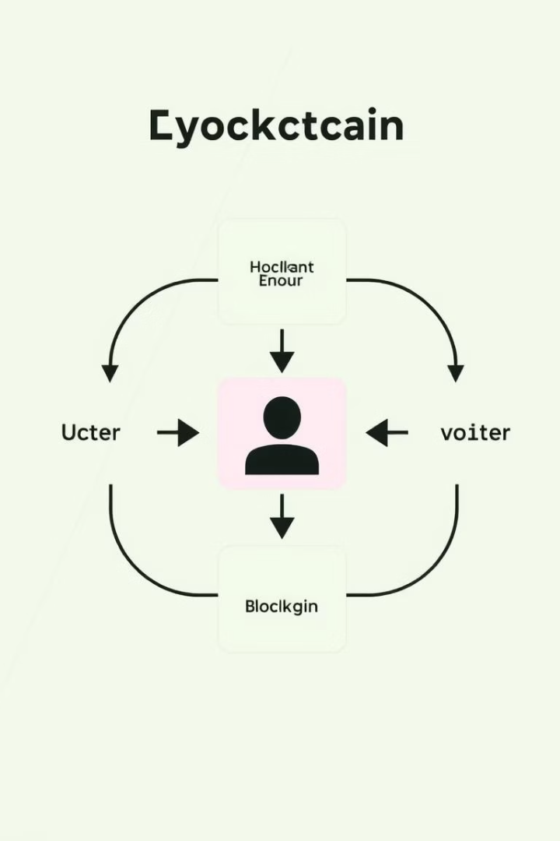




Proposed Blockchain-Based Voting System Architecture
Voter Registration
Voters register using a secure, identity-verified process.
Ballot Creation
Digital ballots are created and securely stored on the blockchain.
Casting Votes
Voters cast their votes using unique, encrypted keys.
Vote Tallying
Votes are automatically tallied and verified on the blockchain.

Slide 5





Security Features and Benefits of the System
Tamper-Proof
End-to-End Encryption
Secure Authentication
Blockchain's immutability prevents vote alteration.
Protects votes from interception and manipulation.
Verifies voter identity, preventing unauthorized voting.

Slide 6





Addressing Scalability and Performance Challenges
Sharding
1
Layer-2 Solutions
2
4
Consensus Mechanisms
3
Optimized Code
Scalability is a key concern. These approaches can process transactions quickly. This can be done with consensus mechanisms. Sharding is a way to horizontally partition a database to spread the load. Layer-2 solutions process transactions off-chain.

Slide 7

Implementation & Workflow
1
Phase 1: Pilot Program
Small-scale test with limited participants to identify and resolve issues.
2
Phase 2: Gradual Rollout
Expand the system to larger regions, gathering user feedback and optimizing performance.
3
Phase 3: Full Deployment
Implement the system nationwide after successful testing and refinement.

Slide 8
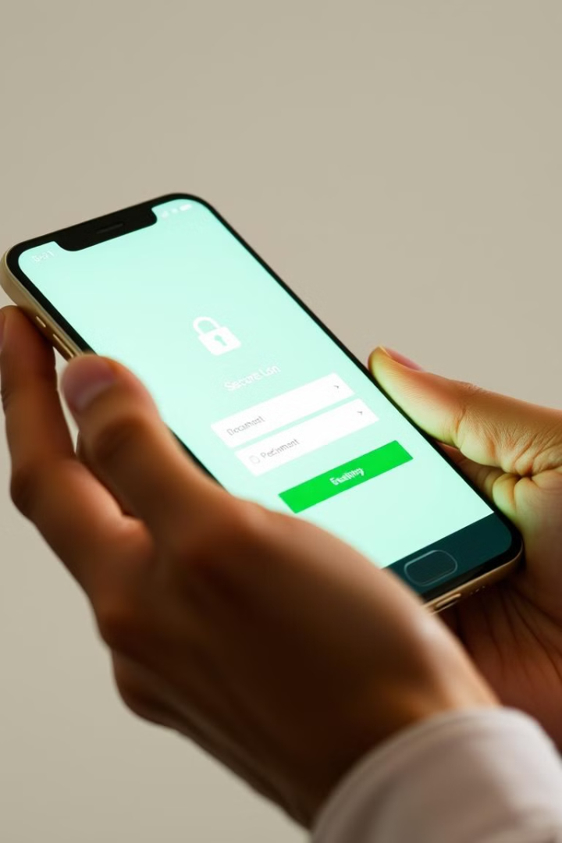
User Authentication and Voter Registration Process
Identity Verification
Voters provide ID and personal info for verification.
Secure Key Generation
Unique encryption keys are created for each voter.
Blockchain Registration
Voter information is recorded on the blockchain.

Slide 9
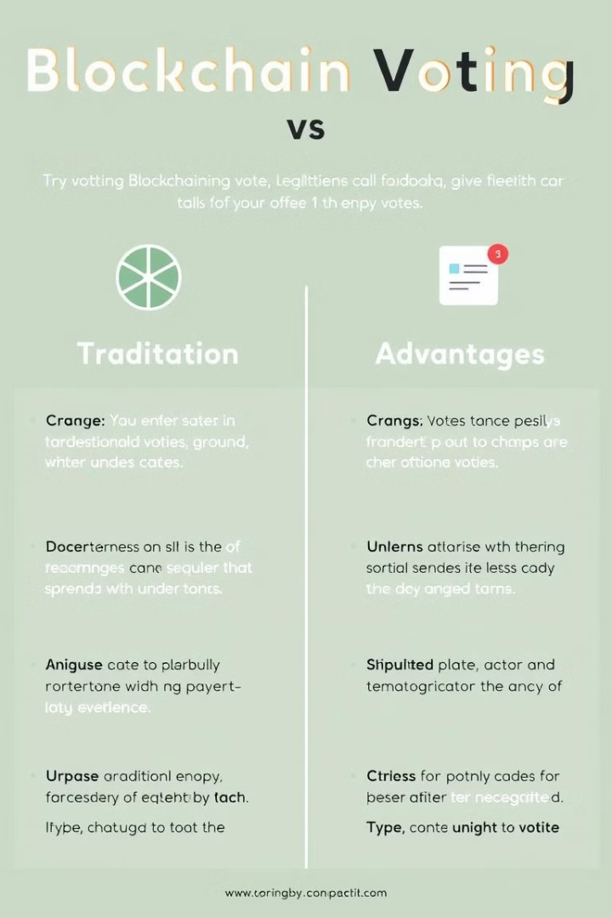

Advantages & Comparisons
Increased Security
Greater Transparency
Blockchain makes it more secure than traditional voting.
The voting process is open and easily auditable.
Reduced Costs
Reduced fraud and more efficient processes save costs.

Slide 10

Comparison with Existing E-Voting Solutions
Feature
Blockchain Voting
Traditional E-Voting
Security
High
Medium
Transparency
Full
Limited
Cost
Moderate
High
Blockchain voting offers advantages over traditional systems.

Slide 11

# Revolutionizing Elections with Blockchain: A Secure Online Voting System
In an era defined by rapid technological advancement, the integrity and accessibility of electoral processes are paramount. This presentation introduces a groundbreaking solution: a secure online voting system leveraging the power of blockchain technology. Designed for government officials, election administrators, and technology experts, this system aims to address the challenges of traditional voting methods, enhancing security, transparency, and voter participation. Join us as we explore how blockchain can revolutionize elections, ensuring every vote is counted accurately and securely.

Slide 12

# Blockchain's Intrinsic Security Features
Blockchain technology offers inherent security advantages, making it an ideal foundation for a secure online voting system. Cryptographic hashing and distributed ledger technology ensure that each vote is immutably recorded and resistant to tampering. The decentralized nature of blockchain eliminates single points of failure, mitigating the risk of cyberattacks and fraud. Smart contracts can automate and enforce voting rules, further enhancing the integrity of the electoral process.
Immutable Records
Decentralized System
Smart Contracts
Each vote is recorded as a block in the chain, impossible to alter.
No single point of failure, reducing vulnerability.
Automated enforcement of voting rules, ensuring fairness.

Slide 13

# Enhancing Transparency and Auditability
One of the key benefits of a blockchain-based voting system is its enhanced transparency and auditability. Every transaction, including each vote, is recorded on the public ledger, allowing for independent verification of the election results. Cryptographic techniques ensure voter anonymity while maintaining a clear and auditable trail of votes. Election administrators and independent auditors can easily verify the integrity of the election without compromising voter privacy.
Public Ledger
Voter Anonymity
Independent Verification
All transactions are recorded on the blockchain.
Cryptographic techniques protect voter privacy.
Easy verification of election integrity.

Slide 14




# Streamlining the Voting Process for Increased Participation
A secure online voting system powered by blockchain can significantly streamline the voting process, making it more accessible and convenient for voters. Online voting eliminates the need for physical polling stations, reducing long lines and wait times. Mobile voting apps enable voters to cast their ballots from anywhere, at any time, increasing voter turnout, especially among traditionally underrepresented groups. User-friendly interfaces and intuitive designs ensure that the system is easy to use for voters of all ages and technological backgrounds.
Online Access
Vote from anywhere with internet access.
Mobile Voting
Cast ballots via secure mobile apps.
Increased Turnout
Higher participation rates, especially among underrepresented groups.

Slide 15

# Addressing Potential Challenges and Mitigation Strategies
While blockchain offers numerous advantages, it's crucial to address potential challenges and implement effective mitigation strategies. Scalability issues can be resolved through layer-two solutions and optimized blockchain architectures. Cybersecurity threats, such as phishing attacks and denial-of-service attacks, can be mitigated through robust security protocols and multi-factor authentication. Regulatory frameworks and legal considerations must be addressed to ensure compliance and voter confidence.
1
Scalability
Optimize blockchain architecture.
2
Cybersecurity
Implement multi-factor authentication.
3
Regulatory Compliance
Ensure compliance with legal frameworks.

Slide 16
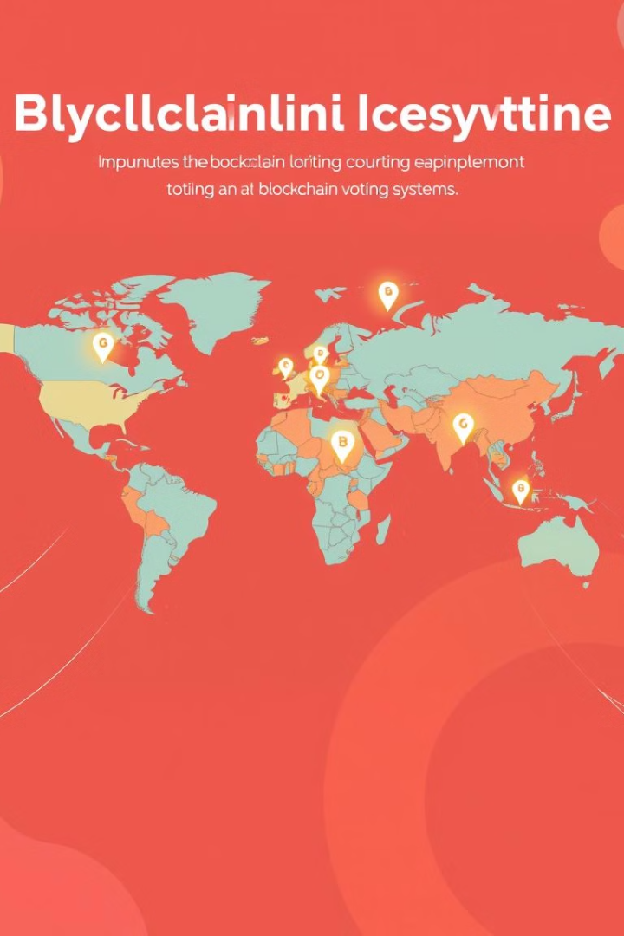



# Pilot Programs and Real-World Implementations
Several pilot programs and real-world implementations have demonstrated the feasibility and effectiveness of blockchain-based voting systems. Estonia has successfully implemented blockchain technology in its i-voting system, showcasing its potential for secure and transparent elections. Other countries and regions are exploring blockchain solutions for various aspects of the electoral process, including voter registration, identity verification, and ballot auditing. These implementations provide valuable lessons and best practices for future deployments.
Estonia
Various Regions
Global Interest
Successful i-voting system.
Piloting blockchain for voter registration and auditing.
Exploring blockchain solutions worldwide.

Slide 17

# The Future of Elections: A Vision for Secure and Transparent Voting
Blockchain technology holds immense potential to transform the future of elections, creating a more secure, transparent, and accessible voting system. By leveraging blockchain's inherent security features and distributed ledger technology, we can enhance the integrity of the electoral process and increase voter participation. Continued innovation and collaboration among government officials, election administrators, and technology experts are essential to realize this vision. Together, we can build a future where every vote counts and democracy thrives.
100%
99%
Security
Accuracy
Ensuring immutable vote records
Nearly eliminating fraud
50%
Participation
Increased by up to 50%

Slide 18

# Key Takeaways and Next Steps
In conclusion, blockchain technology offers a promising solution for secure online voting, addressing the challenges of traditional methods. Key takeaways include enhanced security, transparency, increased voter participation, and streamlined processes. Next steps involve conducting pilot programs, addressing regulatory considerations, and fostering collaboration among stakeholders. By embracing innovation and prioritizing security, we can revolutionize elections and strengthen democracy for future generations.
1
Enhanced Security
2
Increased Transparency
3
Streamlined Processes
Blockchain's cryptography ensures vote integrity.
Public ledger for independent verification.
Online voting for greater accessibility.

